Slide 1
Kellogg Security Process

Slide 2
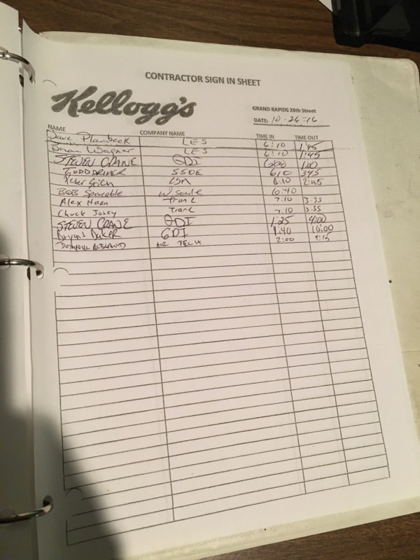
Every day all outside contractors need to sign in when the arrive on site and out when they leave.
The sign in sheet has:
Name
Company
Time In
Time Out
The sheets are also kept daily and would have to be sortable by day.

Slide 3
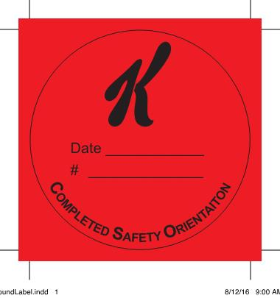
Contractor Safety Training
Every contractor must go through training their first day on site.
Valid for one year before they must sit through the training again.
Once completed the person gets a sticker.
Date the training is completed.
Personal Identification Number explained later.

Slide 4
Safety Training procedure
I have to review and explain the plant specific safety aspects that are pictured on the next slide. The contractors also have the option to read the entire Kellogg Contractor Work Rules if they so choose.

Slide 5
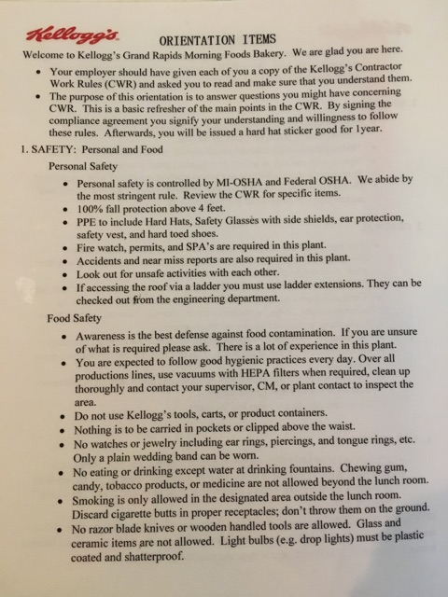
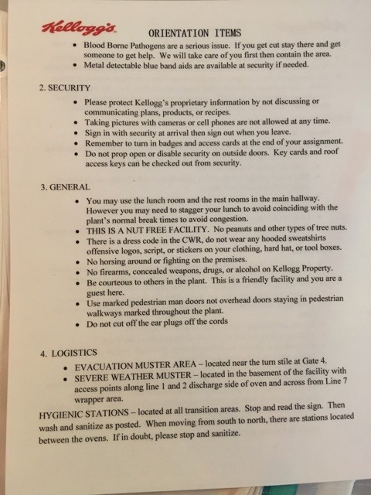

Slide 6
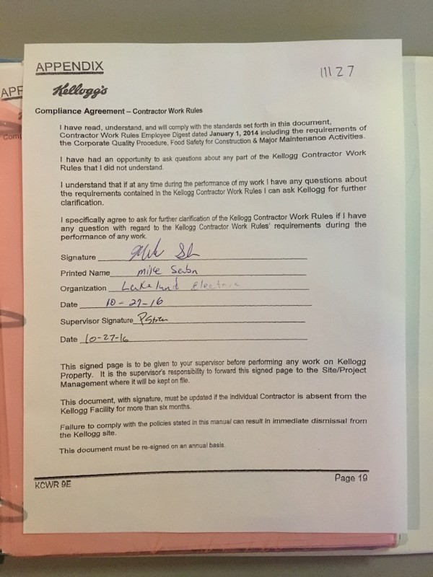
The contractors then sign this sheet as well as whomever is doing the training.
Their PIN is noted again.

Slide 7
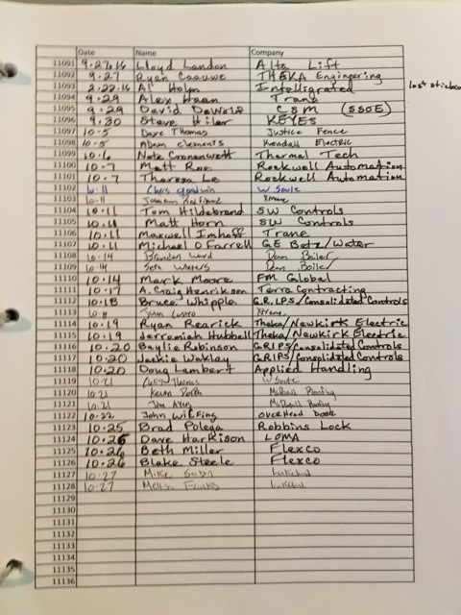
Each contractor is given a number for that year on his or her sticker. This number is only used for record keeping purposes.
The date is recorded along with the individual’s name and company.
I would like the program to notify me when a contractor is signing in and is within a week of needing a refresh on their training.

